Slide 1
lista topologias
Dos fijas Portland y VL2.
La tercera puede ser Spine-leaf (muy básica)..
Las siguientes son variantes de Portland:
Interlinked tree, F2tree
Tambien está la Fat tree.
Para aprovechar que los server normalmente tiene al menos dos tarjetas, está la topología GRIN que puede aplicarse a una topología jerárquica (vl2 o Portland)
NO jerárquicas, no las considero adecuadas para eToriii:
Dpillar, DCell, BCube, MDCube, CamCube, Jelly - fish, Hypercube, SprintNet, “Small-World”
s

Slide 2
Altoona Facebook
Internet
Edge Pod 1
Edge Pod “m"
“?” Ports
1
2
3
4
1
2
3
4
1
2
3
4
1
2
3
4
Edge
48 Ports
“m” Ports
Spine
“n” Ports
48 Ports
48 Ports
Fabric
4 Ports, 40 Gbps
48 Ports, 10 Gbps
ToR
48 Server /ToR

Slide 3
taxonomía topologías
These topologies are commonly classi- fied [15] into switch-centric (e.g. fattree [14] and VL2 [12]) and server-centric (e.g. BCube [7] and DCell [11]) typologies.
what about Jellyfix, hyper…
Leer párrafo primero de Diffflow para CER y articulos
RTT is typically of the order of a few hundreds of microseconds
WCMP, dice direct connect topologies [1, 15, 30 HyperX, Bcube, etc], for con- creteness we focus on multi-stage, tree-based topologies, vl2, fat-tree
HyperX

Slide 5
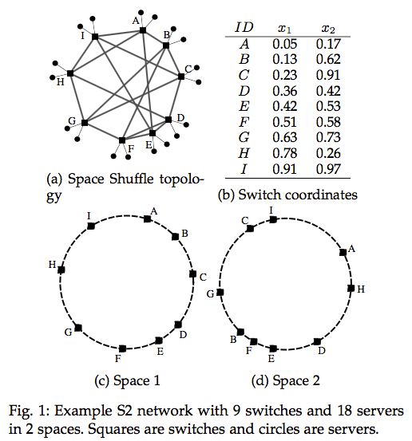
a
Space Shuffle: A Scalable, Flexible, and High-Performance Data Center Network

Slide 6
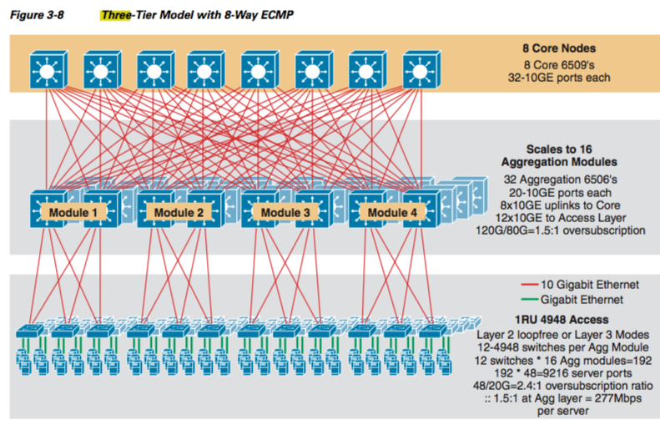
Three-tier A taxonomy and survey on Green Data Center Networks
Cisco Data Center Infrastructure 2.5 Design Guide, Cisco Validated Design, March 9, 2010.
ECMT EQUAL COST MUTIPATH TREE

Slide 7
dpillar

Slide 8
sprint net

Slide 9
small world

Slide 10
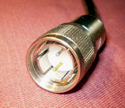
Conceptos básicos de Ethernet
Actualmente los segmentos y hubs y puentes no se usan
Los interfaces Ethernet son full duplex, no hay colisiones
Las velocidades
En cobre, usado en los servidores
hasta 10 Gbps STP, UTP
hasta 40 Gbps 7 m, cable Twinax (foto), se trabaja para 100 Gbps
En fibra óptica
10, 40, usados actualmente en DC en conmutadores de agregación y núcleo
100 Gbps, todavía caro
Siguiente desarrollo 400 Gbps

Slide 11
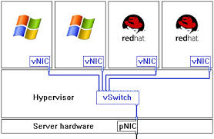
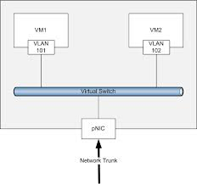
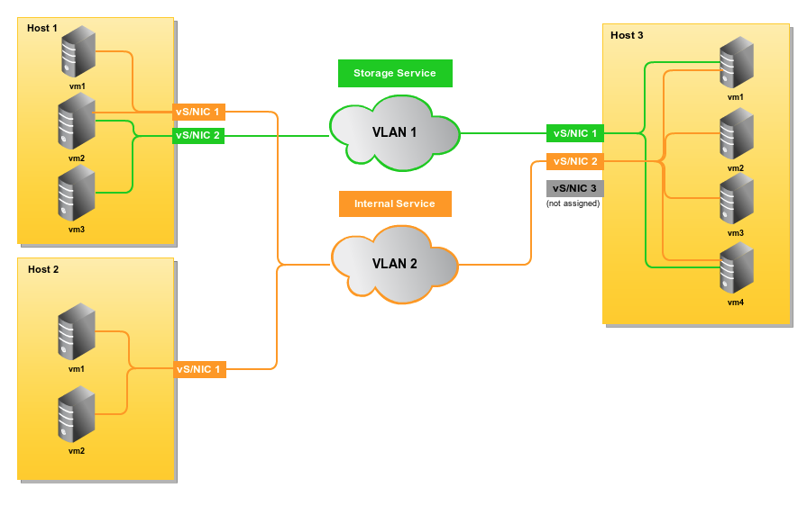
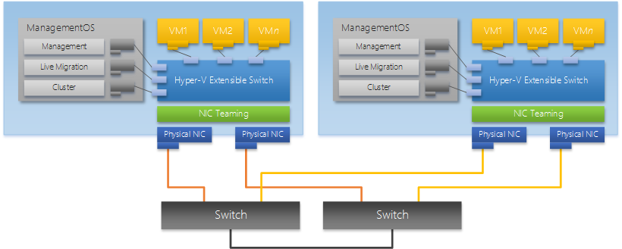
dual-homed

Slide 12
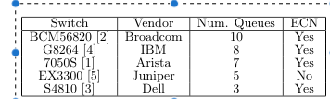
TOR
El Dell tiene 48 puertos a 10 Gbps + 4 a 40
El BCM56820, 24 ports a 10 Gbps

Slide 13
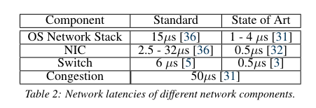
DATOS
flow completion times (FCT) can be as high as tens of milliseconds while in theory these flows could complete in 10-20 microseconds
switches has 10-30 more queue room that the bw*delay
Delay in pFabric is 7,5 usecs

Slide 14
Tráfico de un DC
En general el tráfico es aleatorio
(RTT). In datacenter networks, Tf is typically of the order of a few hundreds of microseconds
TCP, casi todo (99.91% ref DCTCP). Dos tipos de flujos
Elefantes,
Conexiones para transmitir 100MB
Copia de grandes ficheros y las BBDD (varios PB) se dividen en trozos de 100 MB que son replicados (3 veces)
Minería de datos (Map-Reduce dividen BBDD en trozos para análisis)
Movimiento de VM
Son el 99% de tráfico
Necesitan mucho Throughput, insensibles al retardo
Duración en torno a 10-25 seg

Slide 15
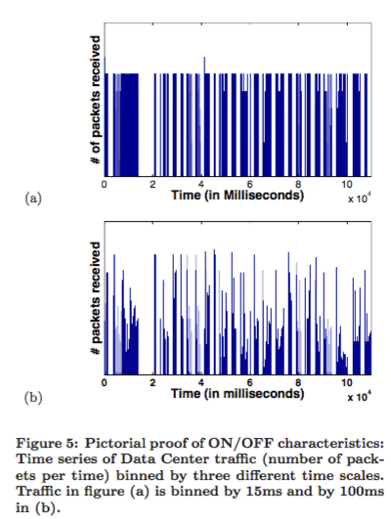
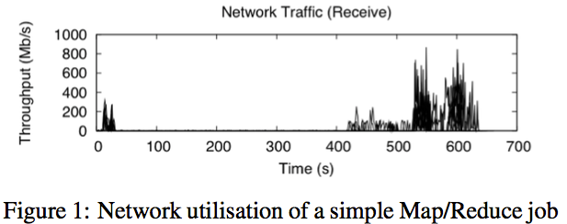
Tráfico de un DC, benson, ruicui grin

Slide 16
Tráfico de un DC
Ratones
Conexiones para transmitir 10 KB
Peticiones web
Son el 98% de las conexiones
Requieren poco retardo
Duración en torno a 200 mseg
El número medio de flujos es de 250 flujos activos/servidor, en VL2 =10
Utilización de los enlaces
En promedio baja
Más alta en enlace Core
Carga sigue patrones diarios, del día de la semana y del mes
Puede haber congestiones de unos 10 seg de duración

Slide 17
Tráfico de un DC
UDP, poca cantidad
Actualizaciones en BBDD
Memcached, construcción de páginas web Flirck, Facebook, con muchos objetos, para solicitar los datos a las BBDD
Replicaciones de datos, sector financiero, redes sociales
Distribución del tráfico
Interior (este-oeste) 80 %, aplicaciones web
Exterior (norte-sur) 20%, aplicaciones big data (MapReduce)

Slide 18
Tráfico de un DC, tipo de comunicaciones
Uno a uno, unicast
Migración de VM
Autenticación de usuarios en el envío de correo
Uno a muchos,
En sistemas distribuidos de ficheros, replicar un fichero
Muchos a uno, incast (puede provocar congestión)
Recopilación de datos de varios servidores para componer la página web de respuesta
Paso intermedio de recogida de una clave en big data
Recopilación de los trozos de un fichero, en un sistema distribuido de ficheros

Slide 19
Tráfico de un DC, características
Tráfico asimétrico, peticiones de los usuarios son abundantes pero de poco tráfico. Las respuestas son mas voluminosas. Una petición web puede implicar consultar a cientos de servidores
Naturaleza del tráfico, muy volátil y a ráfagas, con enlaces casi saturados varias veces al día. Impredecible. Difícil estimar el BW necesario, solución sobredimensionar
80% del tráfico generado por los servidores se queda dentro del rack
Matriz de tráfico (origen/destino), aletorio
Routing ver Fonseca
L3 ECMP, VLB, Hereda, ¿MPTCP?
L2, Trill, Spain, Porland
Direccionamiento, VLAN, VXLAN, Netlord

Slide 20
CD traffic, Benson
Traffic originating from a rack in a data center is ON/OFF in nature with properties that fit heavy-tailed distributions.
In the cloud data centers, a majority of traffic originated by servers (80%) stays within the rack
link utilizations are rather low in all layers but the core. In the core, we find that a subset of the core links often experience high utiliza- tion. Furthermore, the exact number of highly utilized core links varies over time, but never exceeds 25% of the core links in any data center
Losses are not localized to links with persistently high utilization.
Bisection Bandwidth: Recent data center network proposals have argued that data centers need high bisection bandwidth to support demanding applications. Our measurements show that only a fraction of the existing bisection capacity is likely to be utilized within a given time interval in all the data cen- ters, even in the “worst case” Map-reduce
Instant Messaging, Webmail, search, indexing, and video
80% of the flows are less than 11’’
200 Bytes and 1400 Bytes. Surprisingly, we found application keep-alive packets as a major reason for the small packets, with TCP acknowledg- ments, as expected, being the other major contributor. Upon close inspection of the packet traces, we found that certain applications, including MSSQL, HTTP, and SMB, contributed more small pack- ets than large packets
hot-spot links—those with 70% or higher utilization
3% of the links in these two layers appear as a hot-spot for more than 0.1%
Hot-spot only at the core link < 25%
OpenFlow debe soportar 10M de nuevas entradas/sec. Retardo adicional de crear la entrada para flujos cortos, 10 msec
Kandula. 85% of the links observe congestion lasting at least 10 seconds

Slide 21
CD traffic, Benson
(1) In cloud data centers, a significant fraction of traffic stays inside the rack, while the opposite is true for enterprise and campus data centers;
(2) On average, the core of the data center is the most utilized layer, while the data center edge is lightly utilized;
(3) The core layers in various data centers do contain hot-spot links. In some of the data centers, the hot-spots appear only occasionally. In some of the cloud data cen- ters, a significant fraction of core links appear as hot-spots a large fraction of the time. At the same time, the number of core links that are hot-spots at any given time is less than 25%;
4) Losses are not correlated with links with persistently high utilizations. We observed losses do occur on links with low average utilization indi- cating that losses are due to momentary bursts;
5) In general, time-of-day and day-of-week variation exists in many of the data centers. The variation in link utilization is most significant in the core of the data centers and quite moderate in other layers of the data centers.
the number of active flows is small
prevalent traffic patterns in the data centers can be supported by the existing bisection capacity (aggregate capacity of core links), even if applications were placed in such a way that there was more inter-rack traffic than exists today

Slide 22
questions
It is reported that on a DC network, only a small fraction of traffic flows are destined outside the rack

Slide 23
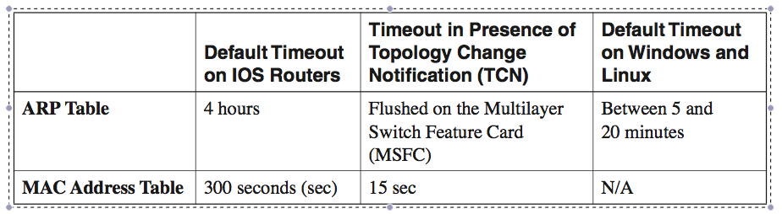
Topologias
En Measuring and Understanding Throughput of Network Topologies, se propone (10 topologías) una métrica para analizar e T en el peor caso de fallo
ver en dir libros el High Performance Datacenter Networks Architectures, Algorithms, and Opportunities

Slide 24
ToR
The Datacenter as a Computer An Introduction to the Design of Warehouse-Scale Machines

Slide 25
Multitenancy
Multitenancy refers to a principle in software architecture where a single instance of the software (e.g. a web server) runs on a server, serving multiple client-organizations (tenants)
With a multitenant architecture, a software application is designed to virtually partition its data and configuration, and each client organization works with a customized virtual application instance (indepedent web server ?)
In a multitenancy environment, multiple customers share the same application, running on the same operating system, on the same hardware, with the same data-storage mechanism. Compare this with virtualization where components are abstracted enabling each customer application to appear to run on a separate virtual machine.
Cost saving, buy one license.
Xiaozhou: In our experiments, the datacenter network is populated by 3000 tenants. The number of VMs per tenant follows an exponential distribution, with min = 10, median = 100, and max = 5000. Each physical end host has at most 20 VMs.
http://en.wikipedia.org/wiki/Multitenancy

Slide 26
Tamaño DC, Curiosities
From :Towards Scalable Traffic Management in Cloud Data Centers:
Up until 2006, Google acquired more than 450,000 servers [4], Amazon’s EC2 cloud is powered by almost 500,000 servers [5]. Microsoft and Yahoo have hundreds of thousands of servers in their data centers [6]. Idem Low Latency Datacenter Networking: A Short Survey .
[5] http://www.wired.com/2012/03/amazon-ec2

Slide 27
fat tree

Slide 28

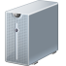
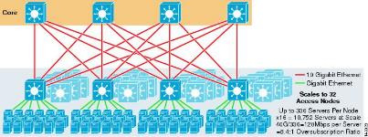
Spine-leaf
Escala media, spine = 1152 ports de 10 Gbps (modelo Huawei) con leaf 2 port a 10 Gbps y 20 a 1 Gbps; 1152x20= 20.000 ports para servers
Se puede forzar con leafs de 2+48 ports, 50.000 servers
http://www.cisco.com/en/US/docs/solutions/Enterprise/Data_Center/DC_Infra2_5/DCInfra_3.html

Slide 29
40 Gbps
Spine
Leaf
Server,40 Gbps

Slide 30
Portland Folded Clos (k factor)
Uses switches of k ports (all with the same type de port 1 or 10Gbps).
Until recently, nonblocking 10-Gbps Ethernet switches were limited to 128 ports. Numerous product announcements claim increased density to 200 to 300 ports.
Three tier topology: core & pod (A Aggr& E Edge)
There are (k/2)² C switches, k pods of k switches (k² switches, A=E=K²/2) & k³/4 servers
A pod is a set of k switches, k/2 A+k/2 E:
Arranged in two rows of k/2 switches (A& E).
Every lower switch (E) connects to every other A (uses k/2 ports)
Every E connects to k/2 hosts or servers.
Every A connects to k/2 C switches.
# ECM = K/2 (ToR), del A al C no hay variedad ni al bajar.

Slide 31
Portland numbers
K (ports== Pods) | # C | #A=#E =2*C | # servers | # VM *16 (4 core CPU)
4 | 4 | 8 | 16 | 256
6 | 9 | 18 | 72
8 | 16 | 32 | 128 | 2048
16 | 64 | 256 | 1024 | 16,384
32 | 256 | 1024 | 8192 | 131,072
48 | 576 | 1152 | 27648 | 442.368
64 | 1024 | 2048 | 65536 | 1,048,576
96 | 2304 | 4608 | 221184 | 3538944
128 | 4096 | 8192 | 524288 | 8,388,608
144 |  |  | 746.496

Slide 32
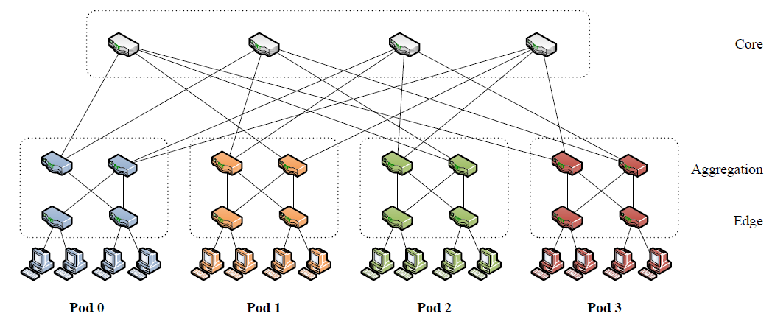
Traffic-aware Virtual Machine Migration in Topology-adaptive DCN
ToR
4ports 10Gbps
48 ports 1Gbps

Slide 33
sacado de DC CER
C₀
C₁
C₂
C₃
A₀
A₁
A₂
A₃
A₄
A₅
A₆
A₇
Pod 0
Pod 1
Pod 2
Pod 3
T₀
T₁
T₂
T₃
T₄
T₅
T₆
T₇
S₀
S₁
S₂
S₃
S₄
S₅
S₆
S₇
S₈
S₉
S₁₀
S₁₁
S₁₂
S₁₃
S₁₄
S₁₅

Slide 34
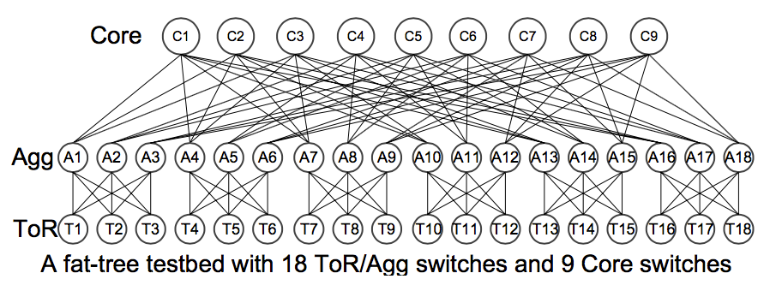
Portland, K=6

Slide 35
VL2 topology generico
Three levels: core (D_{C} ports), aggr (D_{A ports}) & ToR (2+20/40 ports) switches.
Every core sw connect to every (Dc) aggr switch.
Every aggr switch connects to D_{A}/2 core sw and D_{A}/2 ToR sw.
There are:
D_{A}/2 core sw
D_{C} Aggr. Sw
D_{A}D_{C}/4 ToR sw
ToR:
20-40 (1Gbps) servers/hosts
2 (10 Gbps) links to aggr. Switches
# ECM = 2 (ToR)x Dc/2 (Ag) x 2 Core para abajo = 2Dc
switches today only support up to 16-way ECMP, with 256 new one (vl2 , 09)

Slide 36
VL2 topology K=Dc=Da implica quitar la mitad de C y E
Three levels: core (D_{C} ports), aggr (D_{A ports}) & ToR (2+20/40 ports) switches.
Every core sw connect to every (Dc) aggr switch.
Every aggr switch connects to D_{A}/2 core sw and D_{A}/2 ToR sw.
There are:
K/2 core sw
K Aggr. Sw
K²/4 ToR sw
ToR:
20-40 (1Gbps) servers/hosts
2 (10 Gbps) links to aggr. Switches
# ECM = 2 (ToR)x Dc/2 (Ag) x 2 Core para abajo = 2Dc
switches today only support up to 16-way ECMP, with 256 new one (vl2 , 09)

Slide 37
VL2 variaciones
Dc=Da sale que los C tienen mucha conectividad
Da y Dc cualquiera, los A se convierten en cuellos de botella,
Lo habitual K=Dc=Da/2; Da=2Dc, K tiene que ser PAR, para que los ToR salgan número entero. Implica añadir el doble de C y E
#C=K
#A=K
#E=k²/2
#Pod =K/2, cada uno con 2 Agg
Server 20*ToR
VM=320*ToR; 16 vm/hosts

Slide 38
VL2 topology
We observed bursts of link failures caused by protocol issues (e.g.,Cisco UDLD [9]) and device is- sues (e.g., power cycling load balancers).

Slide 39
VL2 numbers Dc=Da=K
K=A=Dc=Da | # C (k/2) | #E =k²/4 | serv.=E*20 | #VM 320*E (16 VMs/server)
4 | 2 | 4 | 80 | 1280
6
8 | 4 | 16 | 320
16
32
48 | 24 | 576 | 11,520 | 184,320
64 | 32 | 1,024 | 20,480 | 327,680
96 | 48 | 2,304 | 46,080 | 737,280
128 | 64 | 4,096 | 81,920 | 1,310,720
144 | 72 | 5,184 | 103,680 | 1,658,880

Slide 40
VL2 numbers Dc=Da/2=K
K=A=Dc=Da/2 | # C=k | #E =k²/2 | serv.=E*20 | #VM 320*E (16 VMs/server)
4
6
8
16
32
48
64 | 64 | 2048 | 40.960 | 655.360
96
128 | 128 | 8192 | 163.840 | 2.621.440
144

Slide 41
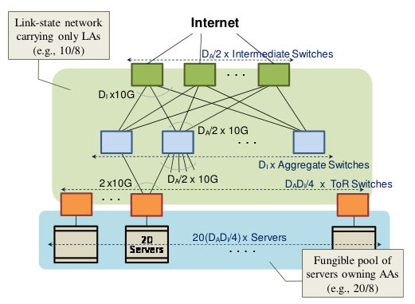
VL2 Greenberg, WREN’10 (sigcomm)

Slide 42
VL2 Dc=Da=4

Slide 43
VL2 Dc=Da=6

Slide 44
VL2 Dc=Da=8
C₀
C₁
C₂
C₃
A₀
A₁
A₂
A₃
A₄
A₅
A₆
A₇
T₀
T₁
T₂
T₃
T₄
T₅
T₆
T₇
T₈
T₉
T₁₀
T₁₁
T₁₂
T₁₃
T₁₄
T₁₅
S₀
S₁₉
S₆₀
S₇₉
S₀
S₁₉
S₆₀
S₇₉
S₀
S₁₉
S₆₀
S₇₉
S₀
S₁₉
S₆₀
S₇₉

Slide 45
VL2 (4,4,20)
C₀
C₁
A₀
A₁
A₂
A₃
T₀
T₁
T₂
T₃
S₀
S₁₉
S₂₀
S₃₉
S₄₀
S₅₉
S₆₀
S₇₉
C₀
C₁
A₀
A₁
A₂
A₃
T₀
T₁
T₂
T₃
S₀
S₁₉
S₂₀
S₃₉
S₄₀
S₅₉
S₆₀
S₇₉

Slide 46
Torii

Slide 47
paris

Slide 48
Interlink
less number of servers to be connected to the topology server computation resource utilization is mostly under 50 percent in today’s DCs [18]
C. Guo, H. Wu, K. Tan, L. Shi, Y. Zhang, and S. Lu, “A Scalable and Fault-Tolerant Network Structure for Data Centers,” Proc.
distribution of flows is 5-10 percent better than that of canonical tree

Slide 49
Internet access

Slide 50
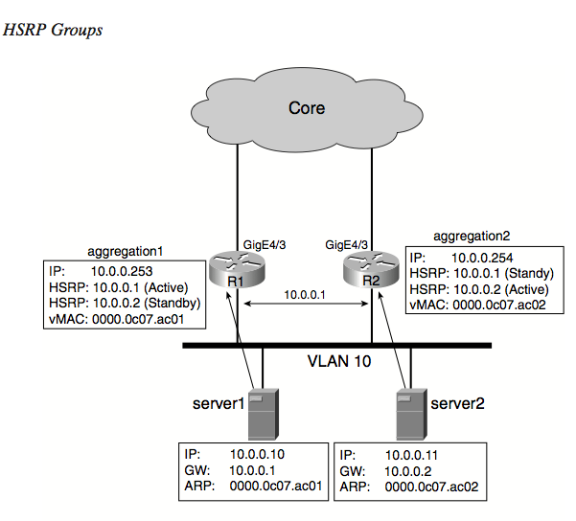
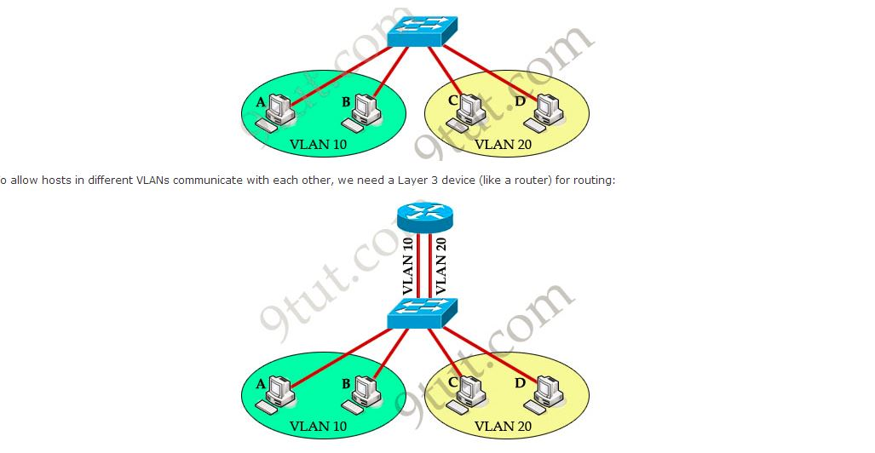
Internet access
protocolo de redundancia, hrsp
router con 4 port y 64 port vlan (1port/core)+1 puente con 65 ports
Red VL2 con 64 cores, 85.000 servers

Slide 51
Internet access Linux on IBM zSeries and S/390: Virtual Router Redundancy Protocol on VM Guest LANs

Slide 52
Internet access
referencias cisco:
2004 Data Center: Load Balancing Data Center
2007 Cisco Data Center Infrastructure 2.5 Design Guide
2012 Virtualized Multiservice Data Center (VMDC) 3.0 Design Guide
2013 Cisco Virtualized Multi-Tenant Data Center, Version 2.2 Design Guide. similar peor que el anterior
Cisco’s Hot Standby Router Protocol (HSRP) Cisco Content Switching Module (CSM) = Load Balancing

Slide 53
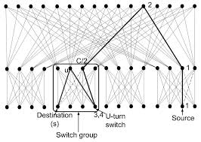

Slide 54
Hyperbolic, Incrementally upgradable data center architecture using hyperbolic tessellations

Slide 55
Hyperbolic, Incrementally upgradable data center architecture using hyperbolic tessellations

Slide 56
MDCube

Slide 57
Jelly-fish como Portland K=4, 16 Servers, 20 puentes

Slide 58
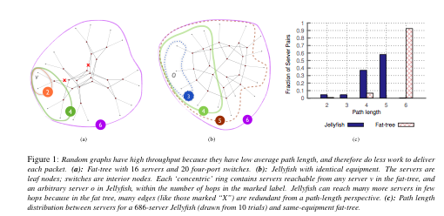
Jelly-fish

Slide 59
Greenberg VL2 09
Core Switches
Aggregation Switches
Edge or ToR Switches

Slide 60
Topologia DC Understanding Network Failures in Data Centers: Measurement, Analysis, and Implications
We observed bursts of link failures caused by protocol issues (e.g.,Cisco UDLD [9]) and device is- sues (e.g., power cycling load balancers).
What Causes Machine Crashes?
Reliably identifying culprits for machine crashes is generally difficult because there are many situ ations in which a transient hardware error can be hard to distinguish from an operating system or firmware bug. However, there is significant indirect and anecdotal evidence suggesting that software-induced crashes are much more common than those triggered by hardware faults. Some of this evidence comes from component-level diagnostics. Because memory and disk subsystem faults were the two most common diagnostics for servers sent to hardware repairs within Google in 2007, we will focus on those.
only approximately 1.3% of all machines ever experience uncorrectable memory errors per year

Slide 61
CLOS topology
Fat tree, is a tree that has links near root with higher data rate
Folder Clos (or multi-rooted trees?) has tree level; core, aggregation, access or edge
Porland (Vahdat ) uses Pod,
4 core switches, 2 link between an aggregation and a core, node
VL2 (Greenberg ) (no Pod), makes a mesh between core and aggregation switches, a load of links

Slide 62
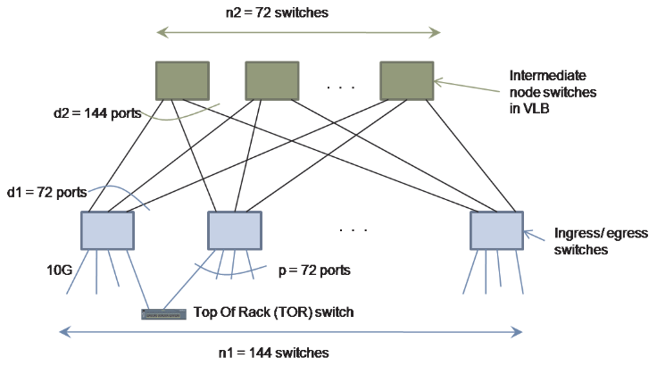
VL2

Slide 63
Porland vs VL2
 | hosts | switches | cables | Alternative path | Port/switch | oversubc | Aggra bw | Bisec bw
Porland | 65536 | 5120 | 131072 (64 fo) | 64 | 64
VL2 | 103680 | 5400 | 20636 | 144 | 144/22
They differ in that (porland) FatTree uses larger quantities of lower speed (1Gb/s) links between switches, whereas VL2 uses fewer faster (10Gb/s) links [MPTCP]

Slide 64

DUAL homing

Slide 65
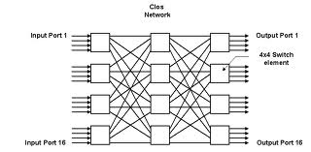
TIPO FLAT
Cayley graphs
Barabasi
Infinetics, propone usar redes simétricas para DC con atajos, análisis

Slide 66
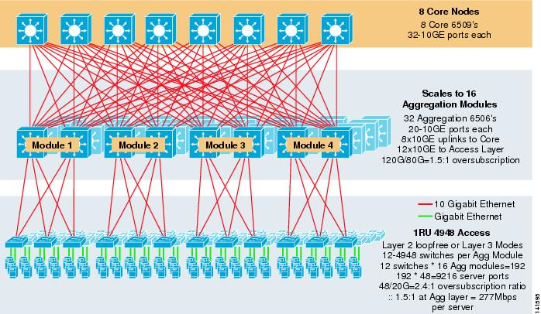
TIPO CLOS FOLDER
ECMT EQUAL COST MUTIPATH TREE
http://www.cisco.com/en/US/docs/solutions/Enterprise/Data_Center/DC_Infra2_5/DCInfra_3.html

Slide 67
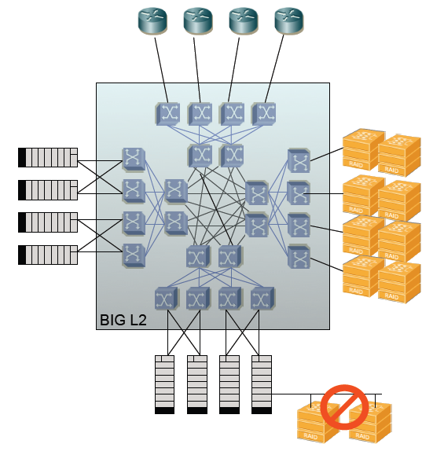
http://nanog.org/meetings/nanog50/presentations/Sunday/IEEE_8021aqShortest_Path.pdf

Slide 68
……………………….
……………………….
5
6
23
24
0
1
3
2
25
26
44
45
……………………….
……………………….

Slide 71
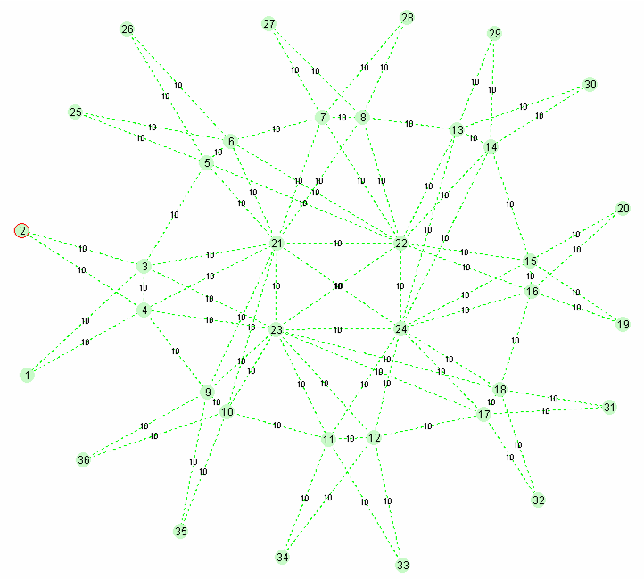
aq-fedyk-SPB-DataCenter-tutorial-0710-v1.ppt
255
255
255
255
255
255
255
Full Transit Replication
255
36 node network
8 member E-LAN ISID=255

Slide 72
Bcube

Slide 73
Dcell

Slide 75
Edge switches caracteristic
 | # 1 Gbps Ports | # 10 Gbps Ports | #multicast
Cisco catalys 3750 Switch | 48 | 2 | 1
HP 11900 | 48 | 2 | 1,5
ToS, has got 48 x 1 Gbps ports and 2 x 10 Gbps and 1500 multicast group entries
ARE NOT suitable for Portland but for VL2
The multicast entries should be: 48/2 port to host= 24; 24 *16 VM/hosts*0,1 subscrition index /VM= 38 entries
OR if snooping is used, 0 byte to id root port get by a hash. subscrition index 12,5%, with 16 VM/port = 2 groups/port: 2 groups/ports*24 ports = 48 G
(3 to id Group+3 bit array)*G = 6 byte/ G; 48*6=288 bytes
or (3 to id Group+d (subscrition index 10% =1,6) use this if is <3)= 6 G or (3+1,6) aprox 5G or 240 bytes
VL2, 20 ports*2 groups/port=40 G
Towards a Flexible Data Center Fabric with Source Routing
Ref de tamaño tablas MAC de
144 K en core
7 k en TOR

Slide 76
C & A switches modules
Switch | # 10 Gbps Ports | #multicast | #unicast | openflow | # IP routing
Cisco Nexus 7000 Switch | 32 | 64000 ACL |  |  | 112k, >6500 512 k (2014)
Dell 4810 | 48 | 8000
HP ProCurve 5400zl | 96 | - | 64000 | 1700 per slot, 12slots (Mahout)
Ciena | 144 x100 Gbps | -
D-Link DES-7200 | 32 | 1000
D-Link DES-6600 | 96 | 4000 | 32K*8=256k
Huawei 12800 | 1152 | ?
Alcatel OmniSwitch x10 | 32*8 = 256 |  |  |  | 256 k
Juniper QFabric | 128 | 4000 | 128,000 through 1,536,000
Mellanox IS5600 | 648 | 4000 | 48K
saw: Broadcom, Fulcrum Microsystems, Woven Systems

